Slide 1
Distributed Systems CS 15-440
Replication – Part I
Lecture 22, October 30, 2022
Mohammad Hammoud

Slide 2
Today…
Last Session:
Caching (or client-side replication) – Part II
Today’s Session:
Replication (or more precisely, server-side replication)
Motivation and definitions
Announcements:
Quiz II is on Tuesday, Nov 1st
PS5 will be posted today. It is due on November 6 by midnight

Slide 3
Overview
Today’s lecture
Motivation
Consistency Models
Data-Centric Consistency Models
Client-Centric Consistency Models
Consistency Protocols
Next two lectures

Slide 4
Overview
Motivation
Consistency Models
Data-Centric Consistency Models
Client-Centric Consistency Models
Consistency Protocols

Slide 5
Why Replication?
Replication is necessary for:
Improving performance
A client can access nearby replicated copies and save latency
Increasing the availability of services
Replication can mask failures such as server crashes and network disconnection
Enhancing the scalability of systems
Requests to data can be distributed across many servers, which contain replicated copies of the data
Securing against malicious attacks
Even if some replicas are malicious, security of data can be guaranteed by relying on replicated copies at non-compromised servers

Slide 6

1. Replication for Improving Performance
Example:
Replication at secondary servers in Content Delivery Network (CDNs)
Main Server
Secondary Servers

Slide 7
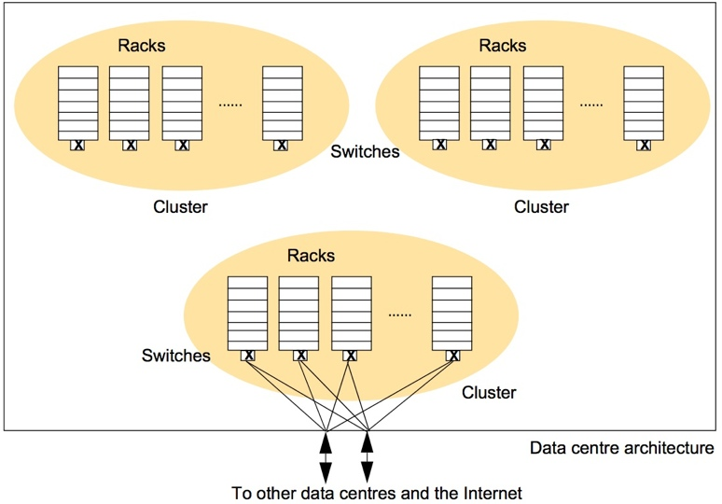
2. Replication for High-Availability
Example:
Google File-System replicates data blocks at computers across different racks, clusters, and data-centers
If one computer or a rack or a cluster crashes, blocks can still be accessed from other sources

Slide 8
3. Replication for Enhancing Scalability
Distributing data across replicated servers helps in saving the main server from becoming a performance bottleneck
Example: Content Delivery Networks can decrease load at main (primary) servers
Main Server
Replicated Servers

Slide 9
4. Replication for Securing Against Malicious Attacks
If a minority of servers in a system are malicious, the non-malicious servers can outvote the malicious ones
This technique can also be used to provide fault-tolerance against non-malicious but faulty servers
Example: In a peer-to-peer system, peers can coordinate to prevent delivering faulty data to the requester
1
5
6
3
7
0
4
2
Number of servers with correct data outvote the faulty servers
n
= Servers that do not
have the requested data
n
= Servers with correct data
n
= Servers with faulty data

Slide 10
Why Consistency?
But (server-side) replication comes with a cost, which is the necessity for maintaining consistency (or more precisely consistent ordering of updates)
Example:
A Bank Database
Event 1 = Add $1000
Event 2 = Add interest of 5%
1
2
Bal=2000
4
Bal=2100
Bal=1000
3
Bal=1000
Bal=1050
Bal=2050
Replicated Database

Slide 11
Overview
Motivation
Consistency Models
Data-Centric Consistency Models
Client-Centric Consistency Models
Consistency Protocols

Slide 12
Maintaining Consistency of Replicated Data
DATA-STORE
Replica 1
Replica 2
Replica 3
Replica n
x=0
x=2
x=5
x=2
x=5
x=0
x=0
x=5
x=2
x=0
x=5
x=2
Process 1
R(x)0
W(x)2
R(x)?
R(x)5
Process 2
R(x)?
R(x)0
R(x)2
Process 3
W(x)5
Strict Consistency
Data is always fresh
After a write operation, the update is propagated to all the replicas
A read operation will result in reading the most recent write
If read-to-write ratio is low, this leads to large overheads
P1
=Process P1
=Timeline at P1
R(x)b
=Read variable x;
Result is b
W(x)b
= Write variable x;
Result is b

Slide 13
Maintaining Consistency of Replicated Data (Cont’d)
DATA-STORE
Replica 1
Replica 2
Replica 3
Replica n
x=0
x=2
x=0
x=0
x=2
x=0
x=5
x=2
x=0
x=3
x=2
Process 1
R(x)0
W(x)2
R(x)?
R(x)5
Process 2
R(x)?
R(x)5
R(x)3
Process 3
W(x)5
Loose Consistency
Data might be stale
A read operation may result in reading a value that was written long back
Replicas are generally out-of-sync
The replicas may sync at coarse grained time, thus reducing the overhead
P1
=Process P1
=Timeline at P1
R(x)b
=Read variable x;
Result is b
W(x)b
= Write variable x;
Result is b

Slide 14
Trade-offs in Maintaining Consistency
Maintaining consistency should balance between the strictness of consistency versus efficiency (or performance)
Good-enough consistency depends on your application
Loose Consistency
Strict Consistency
Easier to implement, and is efficient
Generally hard to implement, and is inefficient

Slide 15
Consistency Model
A consistency model is a contract between:
The process that wants to use the data
and the data-store
A consistency model states the level (or degree) of consistency provided by the data-store to the processes while reading and writing data

Slide 16
Next Lecture…
Replication- Part II

